Slide 1

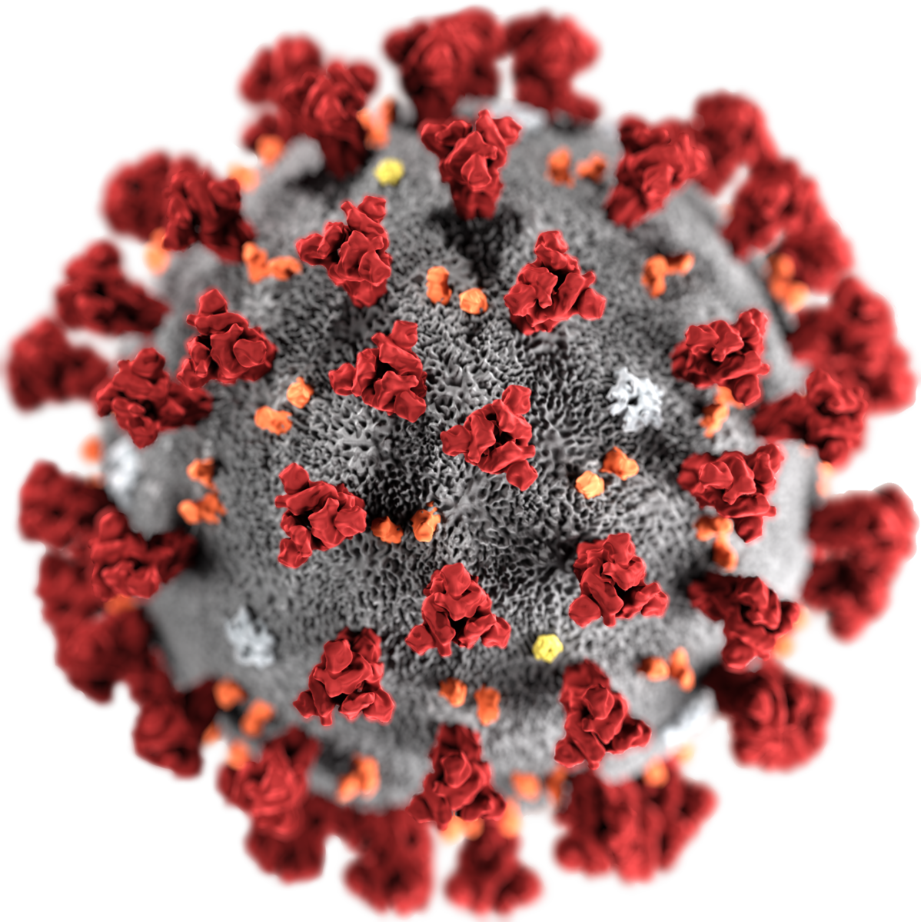
Summary
Impact 1
COVID-19 Impacts
On
Business and Workforce Trends
Impact 2
Impact 2
Impact 3
COVID-19 Impacts
Business
&
Workforce Trends
Impact 4
Impact 5
Team

Slide 2
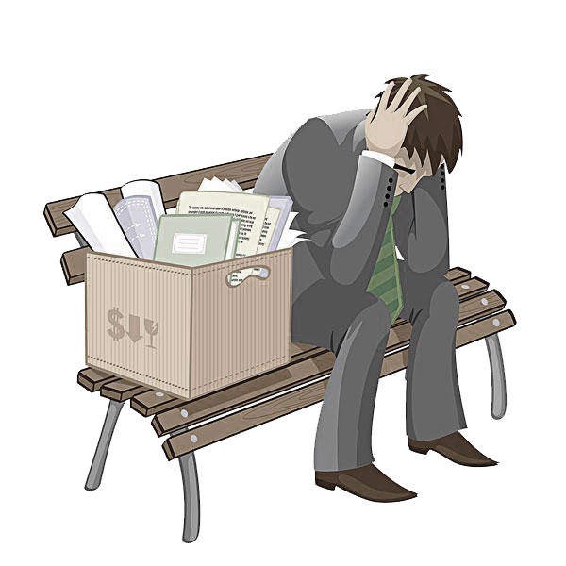

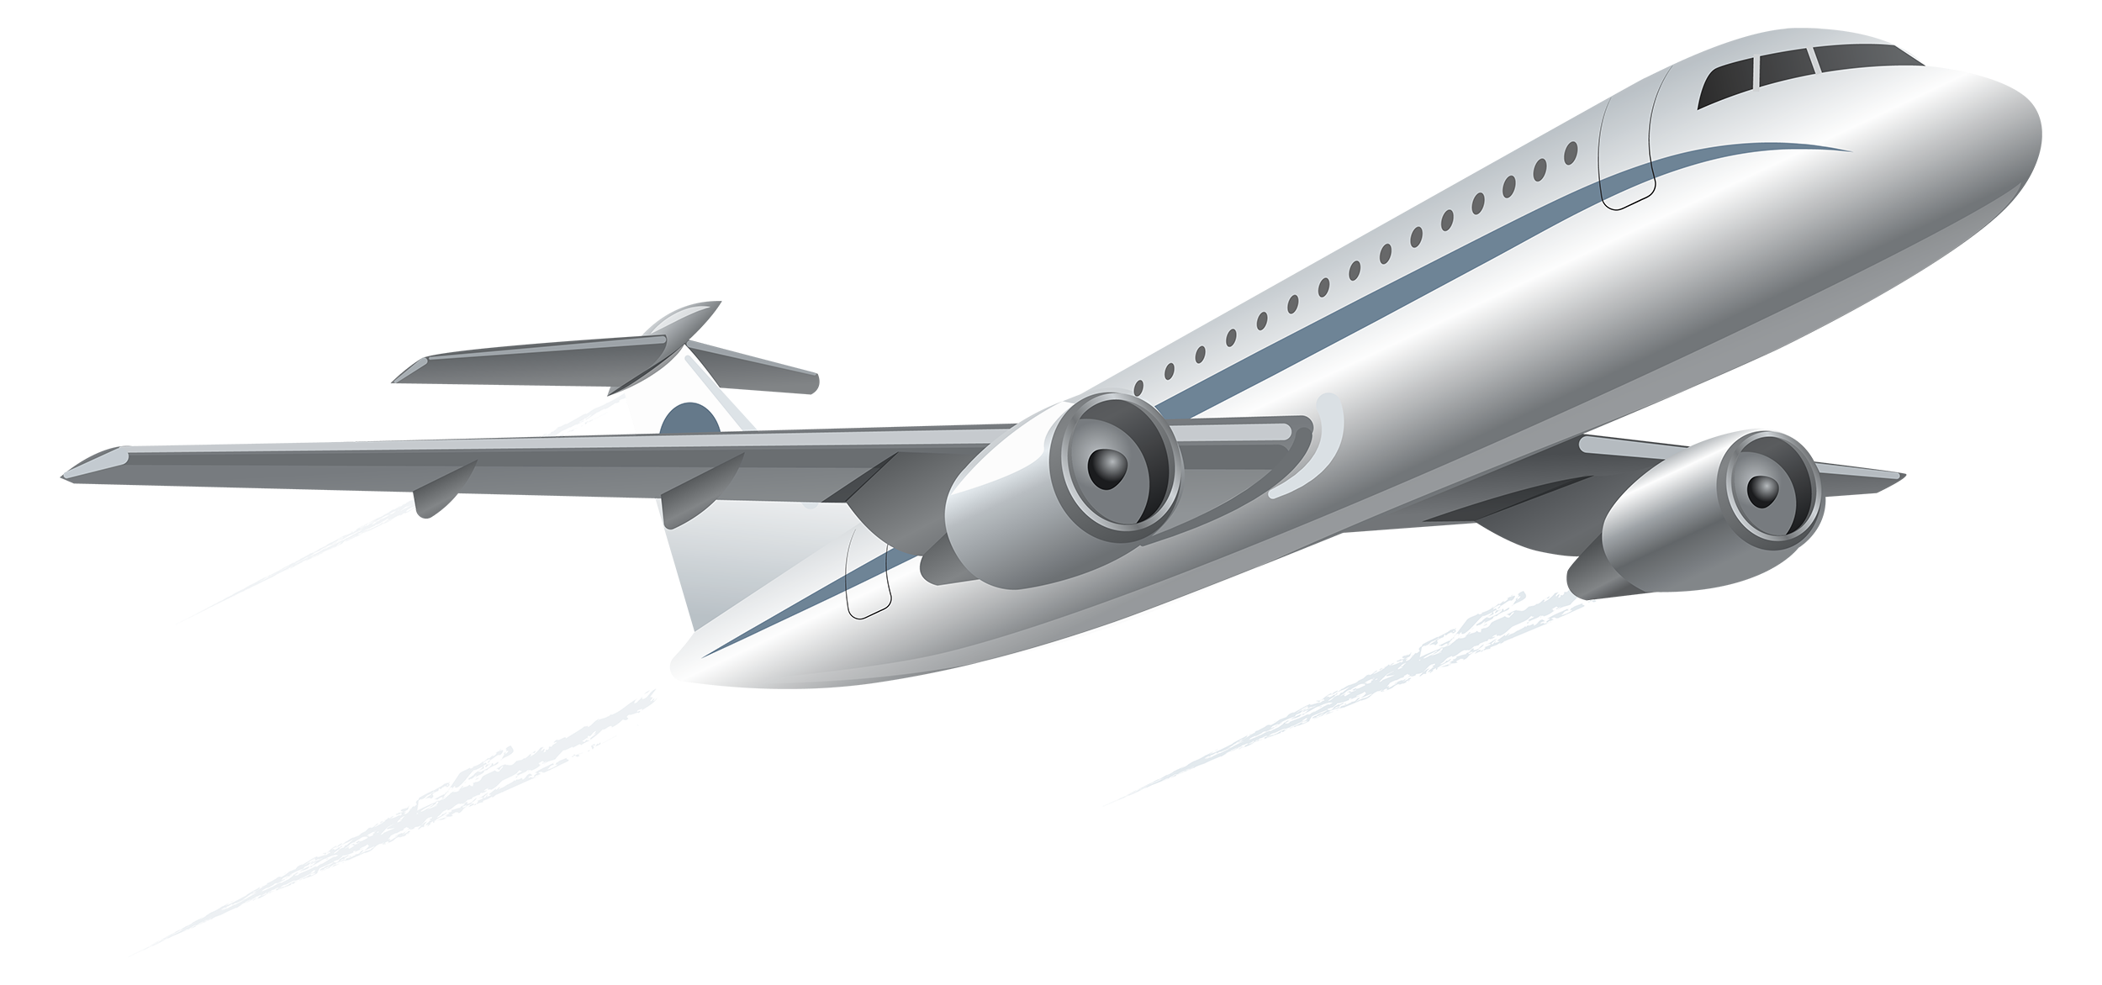


COVID-19 Impact: Business & Workforce Trends
This project analyses the effect of COVID-19 pandemic in US on
business performance trends through several metrics
Summary
Impact 1
Unemployment
Businesses
Impact 2
Impacts on unemployment rates of various groups during the pandemic in US
Impacts on business performance during the pandemic in US
Impact 3
Airlines
Impacts of COVID-19 travel restrictions
Impact 4
Mobility
Safest Travel Destination
Impact 5
Impact of COVID-19 cases on the mobility trends in US
Impact of COVID-19 on travel destinations in US
Team

Slide 3
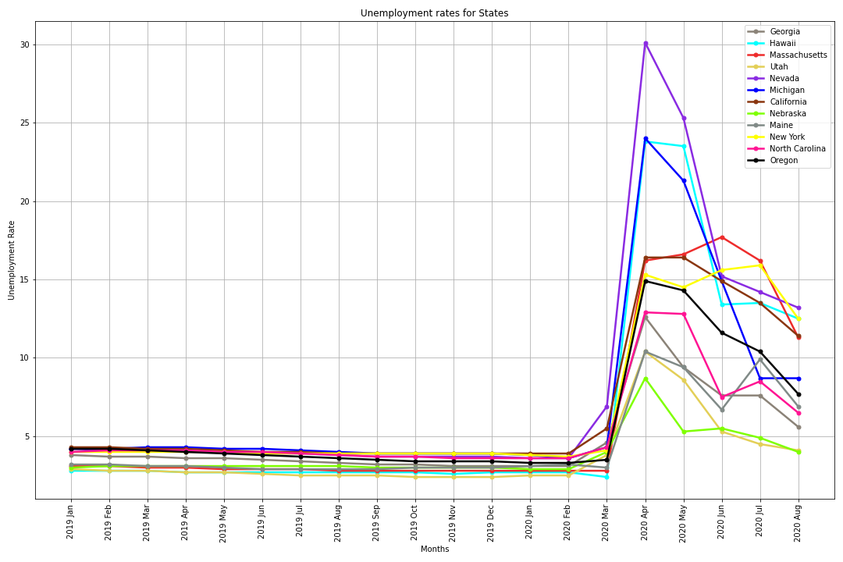
Impact of COVID-19 on Unemployment
Summary
State Unemployment Rates Due to COVID-19
Impact 1
Nevada
Impact 2
Hawaii
Michigan
Impact 3
20%
Impact 4
Impact 5
Team

Slide 4
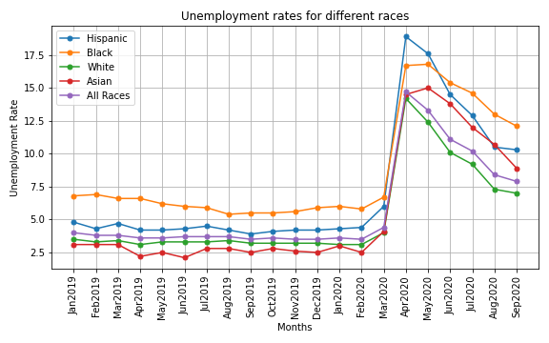
Impact of COVID-19 on Unemployment
Summary
Unemployment Rates By Race
Impact 1
Impact 2
Impact 3
Impact 4
Impact 5
Team

Slide 5
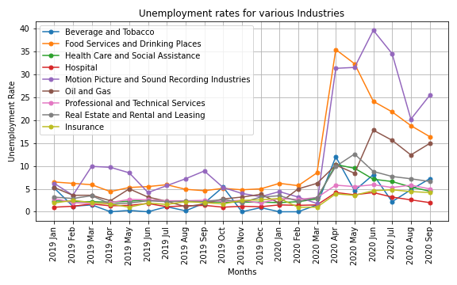
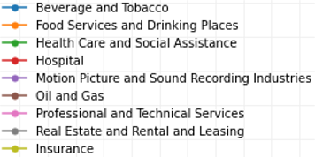
Impact of COVID-19 on Unemployment
Summary
Unemployment Rates By Industries
Impact 1
Impact 2
Impact 3
Impact 4
Impact 5
Team

Slide 6
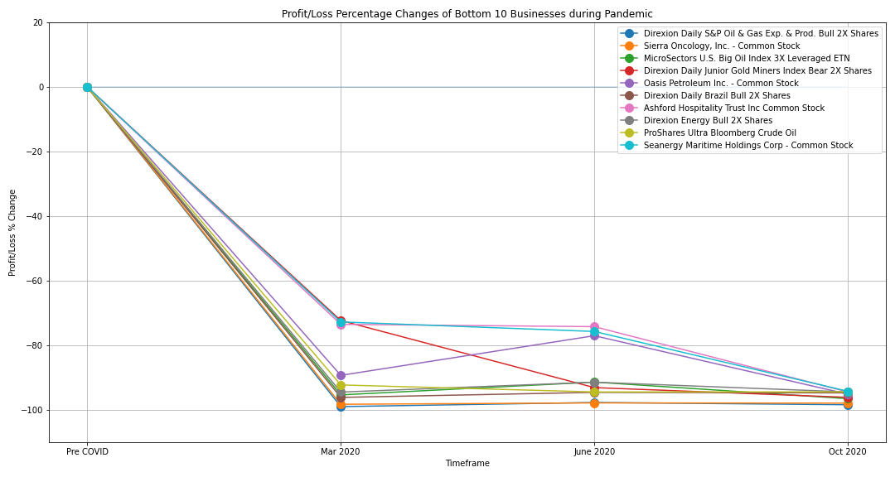
Ten Worst-Performing Companies During the Pandemic
Summary
4
Oil & gas
2
Gold & silver
mining
1
Transport & Shipping
1
Impact 1
Real-estate
1
Diagnostic & Clinical Testing
1
Hospitality
Impact 2
3 companies had smaller decreases in average stock prices (≅ 72%):
real-estate
Shipping/transport
Gold/silver mining
Impact 3
Impact 4
4 of 7 companies with average decreases of 95-98% were oil/gas companies
Impact 5
All stock prices had a 100% decrease by October 2020
Team

Slide 7
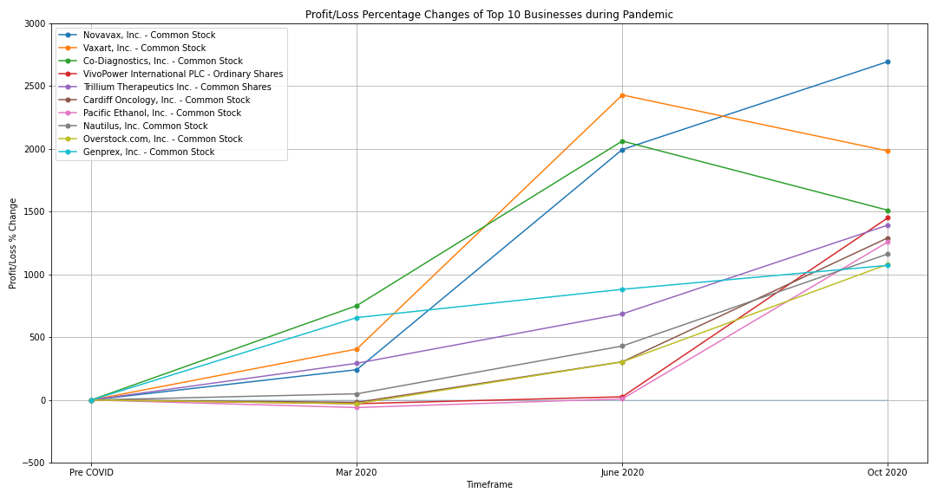
Top Ten Profiting Companies During the Pandemic
Summary
6
Biotechnology & Vaccine Development
1
Internet Retailer
1
Fitness Equipment
2
Alternative Fuels & Solar power
Impact 1
3 diagnostic/ vaccine development companies had significant average stock price increases (>1500%) between March and June.
Impact 2
Impact 3
Impact 4
7 companies had average gains of about 250% between March and June
Impact 5
Team

Slide 8
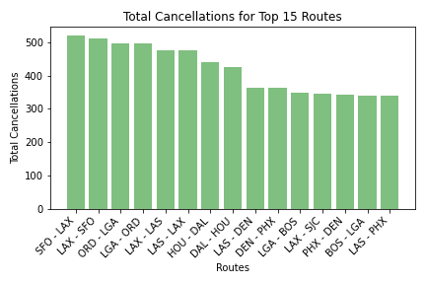
Impact of COVID-19 on Travel Routes / Airlines
about
Most Affected Travel Routes (Jan - Jun 2020)
Impact 1
521
Impact 2
Impact 3
Impact 4
Impact 5
Team

Slide 9
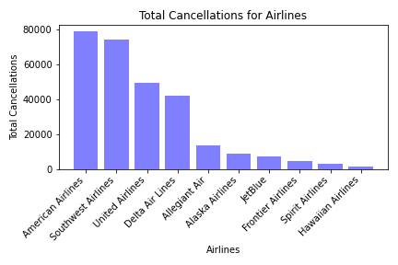
Impact of COVID-19 on Travel Routes / Airlines
about
Most Affected Airlines (Jan - Jun 2020)
Impact 1
78,000
Impact 2
Impact 3
Impact 4
Impact 5
Team

Slide 10
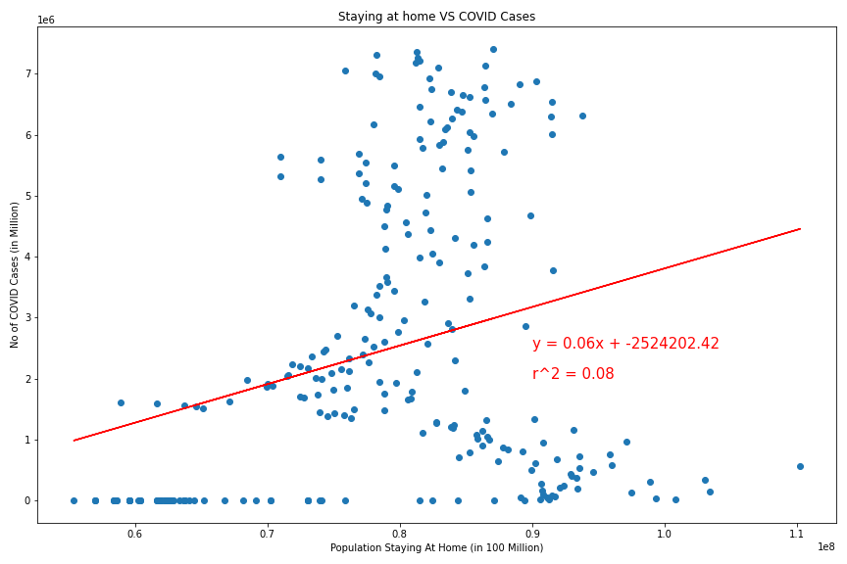
Impact of COVID-19 on Mobility Trends
Summary
Correlation Between Population Staying at Home & COVID-19 Cases
Impact 1
Impact 2
Impact 3
Impact 4
8%
Impact 5
Team

Slide 11
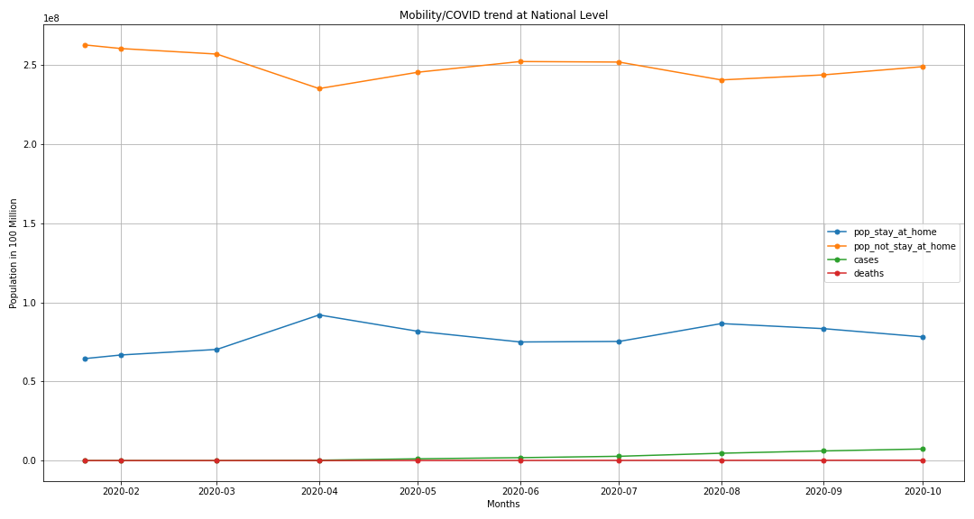
Impact of COVID-19 on Mobility Trends
Summary
Mobility Trend vs COVID Cases/Deaths Trend at National Level
Impact 1
Impact 2
Impact 3
31%
19%
Impact 4
Impact 5
Team

Slide 12
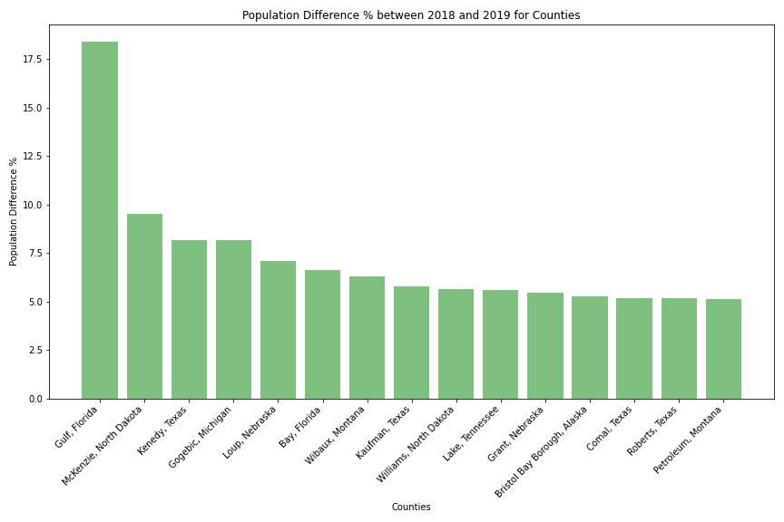
Safest Travel Destination
Summary
Representative Population Estimated from 2019
Impact 1
Impact 2
Impact 3
Impact 4
Impact 5
Team

Slide 13
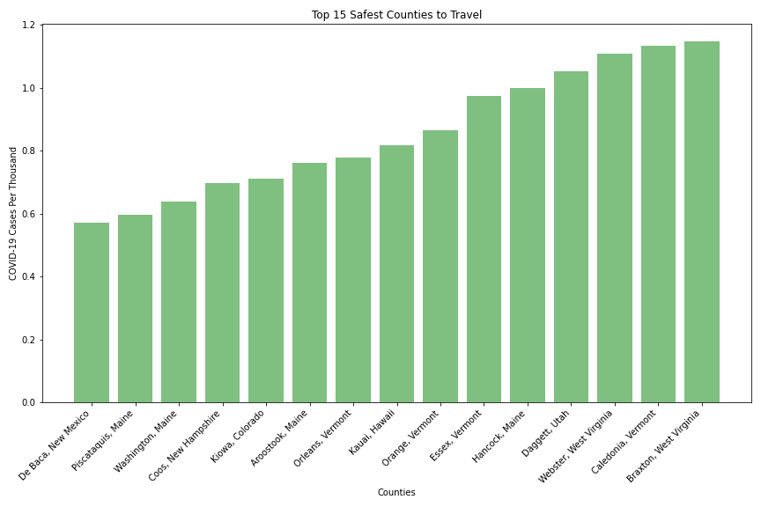
Safest Travel Destination
Summary
Top 15 Safest Counties in US
Impact 1
Impact 2
Impact 3
Impact 4
Impact 5
Team

Slide 14
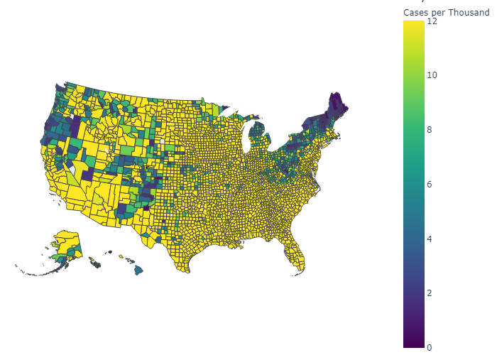
Safest Travel Destination
Summary
US County Level Map with Cases per Thousand
Impact 1
Impact 2
Impact 3
Impact 4
Impact 5
Team

Slide 15






Team Members
Summary
Impact 1
Jame’l
Unemployment Impacts
Impact 2
Usha
Chahnaz
Business Impacts
Business Impacts
Impact 3
Impact 4
Prarthna
Crystal
Mobility Impacts
Safest Travel Destination
Impact 5
Susan
Airlines and Travel Route Impacts
Thanks for Listening with great patience
Team

